Slide 1
Designing an online experiment to study manual inhibition
Kolloquium Allgemeine Psychologie
Clara Kuper

Slide 2



The world can surprise us …
Pro- and Antisaccades are inhibited (Reingold & Stampe 2003)
Microsaccades are inhibited (Tian et al 2016)
Inhibition depends on the concious detection of the change (White & Rolfs 2016 )
Re-bound of microsaccades in the direction of the novel stimulus (Hafed & Ignashenkova 2013)
Less salient stimuli also result in inhibition (Buonocore et al 2018)
… how do we adapt to these surprises?

Slide 3
The world can surprise us …
Saccades are more precise after inhibition through a salient, global distractor.
(Buonocore et al 2017)
Aborting and re-planning a saccade is more time-efficient than correcting after the movement landed.
(Salinas & Stanford 2018)
… how do we adapt to these surprises?

Slide 4
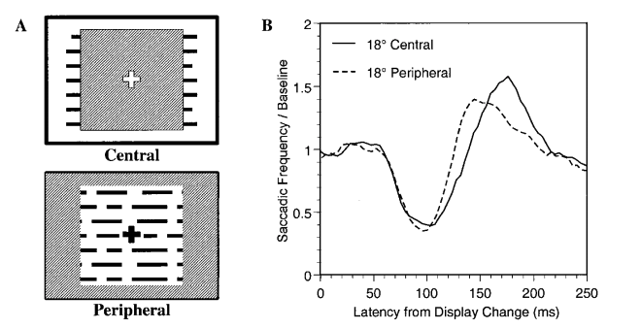
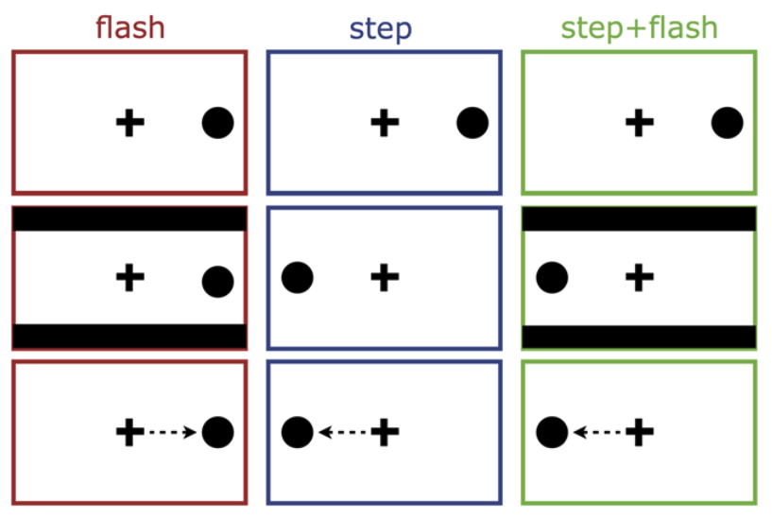
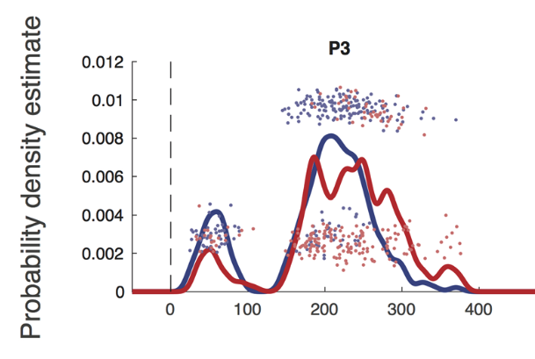
A universal mechanism?
Inhibition in onset-driven saccades
Inhibition in sequentially planned saccades
Buonocore et al 2017
Reingold & Stampe 2004

Slide 5

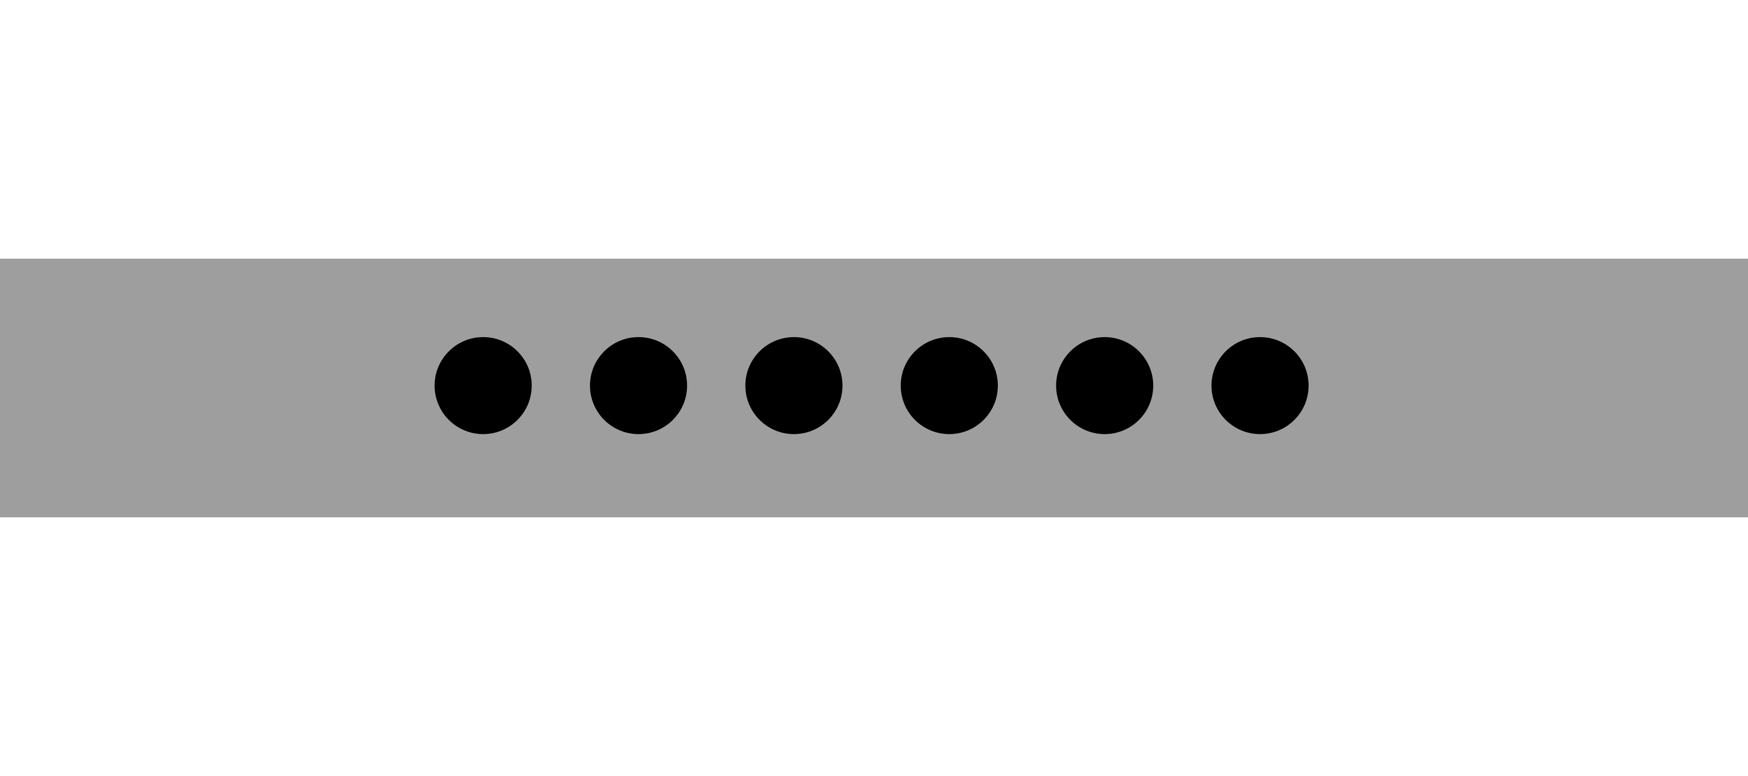






A universal mechanism? Only for saccades?
Jump
Task
Fixation
Serial
Task
Collection Start
Go Signal
Flash
Flash
Flash+Shift
Collection End
Response

Slide 6




Bringing the task online. The toolbox
Coding
Server
Recruitment
Lab member pilot:
6 sessions (5 subjects)
Jump Task: 160 trials (960)
Serial Task: 150 trials (900)
JATOS
Javascript based library
Event-oriented study design
Combined with custom html & javascript
Tool for hosting the study on a server
Installed on Humboldt Psychology servers
Takes care of data storage
European platform for online experiments & surveys
Anonymous subjects
30% serivce fee

Slide 7
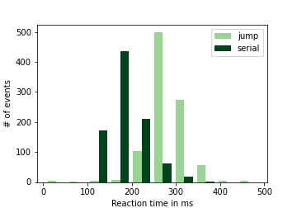
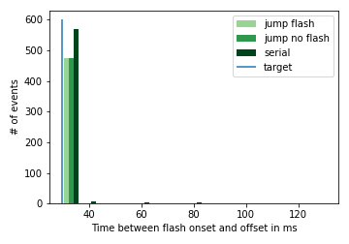
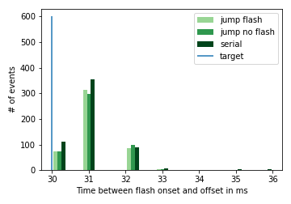
What could go wrong?
Flash duration
Response times
Slow screen refreshes, but accurate within
these limits.
Response times differ between tasks, but the ranges seem reasonable.

Slide 8
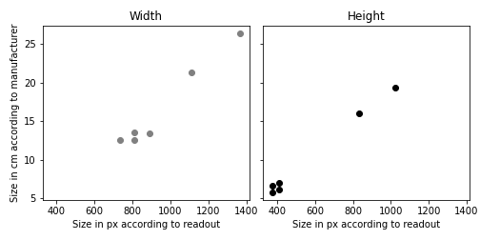
What could go wrong?
Screen sizes
Tablets
Usable window size & screen size correlate.
Phones
But where do the differences come from?
1 px = 0.026 cm

Slide 9
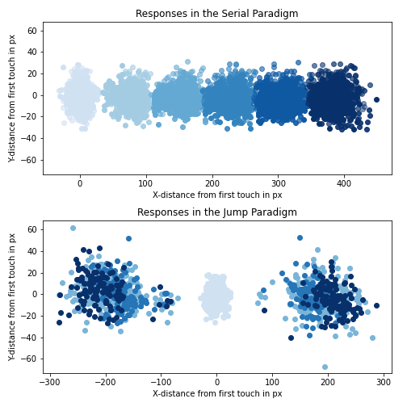
After all – how does it look?
(Not too bad)

Slide 10
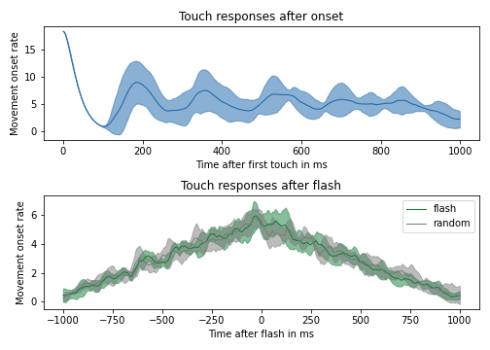
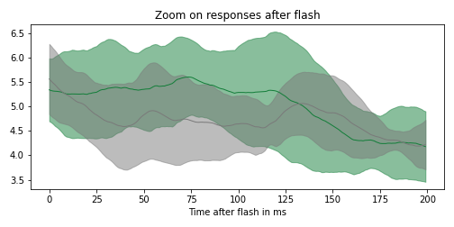
Are manual responses inhibited? The serial task.

Slide 11
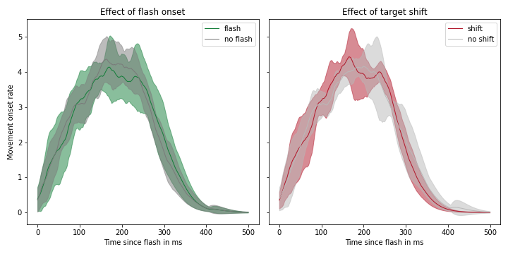
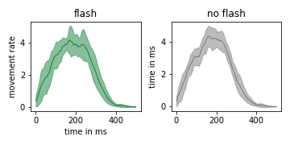
Are manual responses inhibited? The jump task.

Slide 12
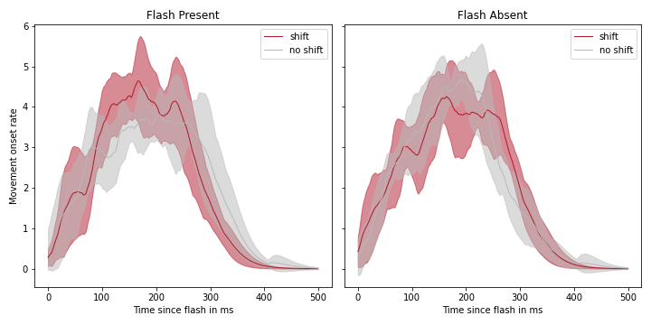
Are manual responses inhibited? The jump task.

Slide 13
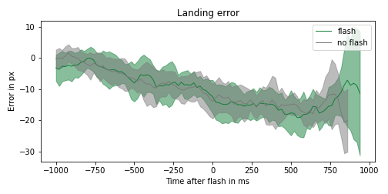
Is the movement more precise after a salient distractor?
The serial task
Response accuracy decays over time
Response accuracy does not increase
after a flash.

Slide 14
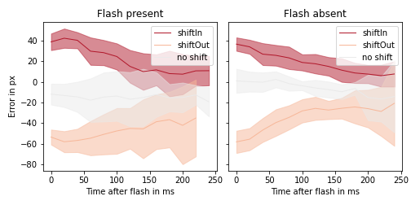
Is the movement more precise after a salient distractor?
The jump task
Response accuracy increases with longer exposure to the stimulus.
Presenting a flash or not does not seem to make a difference.

Slide 15



Conclusion
No evidence for an effect of salient flashes on manual responses
limited data?
limited salience?
limited behavioral relevance?
Inhibition only helpful for open-loop motor control?
Inhibition only helpful for saliency-driven movements?
THANK YOU!

